Slide 1
Buying your first home
Oleg Galyuk
Sutton WestCoast Realty

Slide 2
Overview
Where to start your search?
Working with buyers agent
Making and offer
Offer acceptance
Inspections, financing and removing subjects
Closing date and possession of the property
Expenses

Slide 3
Where to start?
42% of buyers in North America Start their search online
Websites like: realtor.ca and realtylink.org
Look for open houses
REW.ca (real estate weekly)

Slide 4
REW.CA

Slide 5
Questions to ask REALTOR® at an open house (NON-STRATA)
How long has the property been on the market?
Have there been any offers? (How much?)
Oil tank? (if applies)
GST? (new construction)
Why is seller moving?

Slide 6
Questions to ask REALTOR® at an open house (STRATA)
Rain screen? (older buildings especially)
By-law restrictions? (especially pets & rentals)
Contingency fund amount?
Upcoming works on the building?
Last time roof was replaced? (older buildings)
Total number of units in the building?

Slide 7
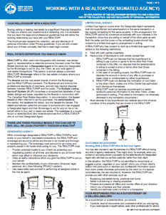
Working with buyers agent?
Designated Agency. Buyers agent works for you.
Negotiating on your behalf
Find recently sold properties in the area
Comparative analysis
Schedule viewings
Take care of all paperwork

Slide 8
Working without buyers agent?

Slide 9
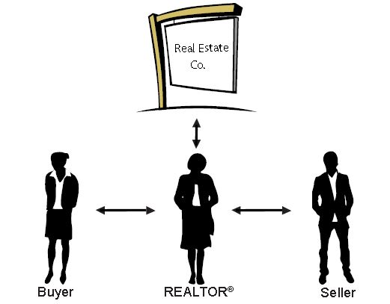
Working without buyers agent?
Can probably get some money back
Legally must give you impartial advice
Limits the rights of the agent
Agent takes on full liability

Slide 10
Financing pre-approval pros
Know your exact budget
Better negotiation position
Less hassle when offer is accepted
Advantage in multiple offers situation
Lock-in low interest rates

Slide 11
Financing pre-approval cons
Pressure to buy within set time period (60-90 days)
Interest rates could get lower
Heavy pull on your credit score every time you need to apply

Slide 12
Mortgage broker vs bank?
Mortgage broker works with many institutions and finds best interest rates & terms for clients
Bank can only offer their own interest rates

Slide 13
Making an offer
Documents to complete:
Working with a realtor brochure
Individual Identification Information Record
Contract of Purchase and Sale
Schedule “B”
Disclosure of Remigration

Slide 14
Lowball offers
Pros:
You might get it
Get a good counter
Cons:
Get no counter
Lose your negotiation power
Lose the property

Slide 15
Offer subjects and clauses
Financing subject
Inspections subject
Strata documents: form b, 2 years worth of minutes, strata plan, depreciation report, strata financial reports, bylaws
Any additional subjects

Slide 16
Accepted offer – Closing date
Get a lawyer or a notary (real estate agency will send them your documents)
Arrange for insurance
Pull together your closing costs *
Arrange moving

Slide 17
Accepted offer
Get your financing
Inspections
Review documents
Remove subjects (within 7-20 days)

Slide 18
Closing date
Annual property taxes calculation
Property transfer tax due (if applicable)
Money gets deposited into sellers account
Property title gets transferred onto your name

Slide 19
Closing expenses
Inspections - $300-1500
Notary & Lawyer fees - $800-$1500
Property Transfer Tax 1% on first $100,000 & 2% on every $100,000 after (first time homebuyer savings apply)
GST (if applicable)
Clearing title, surveys & other $500+
Mortgage fees (usually added on to over all mortgage total)

Slide 20
Possession date!

Slide 21
Everything Real Estate Meetup Group
Thank you for coming!
Oleg Galyuk
604-565-7052

